Slide 1
Value Stream Mapping at NCS
Presented to: Gunnison
Date: 4/2/2014

Slide 2
Topics
What is the Value Stream?
What is Value Stream Mapping?
Why Map the Value Stream?
Mapping the Value Stream

Slide 3
The Value Stream
The flow of work involved in turning an idea into a product that can be consumed by the customer.

Slide 4
Value Stream Mapping
Value stream mapping is a lean enterprise technique used to document, analyze and improve the flow of information or materials required to produce a product or service for a customer.
Current State – clarify, follow the work, map and assess
Future State – create and work toward
No underlying assumption
No framework

Slide 5
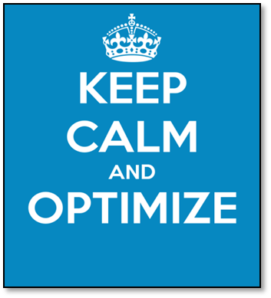
Why Map the Value Stream?
See and understand the whole process (value stream)
Optimize entire stream instead of just your own section of the stream
Prioritize efforts
Agreement on current state
Agreement on what the future state should look like – a shared focus on continuous improvement effort
Unnecessary Non-Value Added
Rework
Unnecessary layers of approval
Unread reports
Non-productive meetings
Necessary Non-Value Added
Business requirements
Training
Inspection
Value Added
Customer willing to pay for it
Done right first time
Something customer wants

Slide 6
Mapping the Value Stream
Identify the actions taken in the value stream
Calculate the calendar time for each action
Calculate actual time worked on the action
Identify the time between actions
Identify any loop backs required
Calculate the Process Cycle Efficiency/Metrics

Slide 7
Mapping the Value Stream
Identify the actions taken in the value stream
Deployment package
Instrument Specifications
MDES
MDES Specifications
XSD
VDR Database

Slide 8
Request Spec. Review
In Review
Finalize Instruments
MDES Development
MDES QC
OMB/IRB
[??]
Code List Generation
BAH QC
XSD
VDR Data Model
Deployment Package
Request
MDES Spec
MDES Spec

Slide 9
Mapping the Value Stream
Calculate the calendar time for each action

Slide 10
Request Spec. Review
In Review
Finalize Instruments
MDES Development
MDES QC
.5
4
.5
16
4
OMB/IRB
[??]
120
Code List Generation
BAH QC
XSD
VDR Data Model
Deployment Package
40
24
24
240
Request
MDES Spec
MDES Spec
.5
120

Slide 11
Mapping the Value Stream
Calculate actual time worked on the action

Slide 12
Request Spec. Review
[0]
In Review
[2]
Finalize Instruments
[0]
MDES Development
[12]
MDES QC
[2]
.5
4
.5
16
4
OMB/IRB
[??]
120
Code List Generation
[24]
BAH QC
[4]
XSD
[2]
VDR Data Model
[80]
Deployment Package
40
24
24
240
Request
MDES Spec
[0]
MDES Spec
[80]
.5
120

Slide 13
Mapping the Value Stream
Identify the time between actions

Slide 14
Request Spec. Review
[0]
0
In Review
[2]
0
Finalize Instruments
[0]
0
MDES Development
[12]
0
MDES QC
[2]
.5
4
.5
16
4
OMB/IRB
[??]
120
0
Code List Generation
[24]
0
BAH QC
[4]
0
XSD
[2]
0
VDR Data Model
[80]
0
Deployment Package
40
24
24
240
Request
MDES Spec
[0]
0
MDES Spec
[80]
0
.5
120

Slide 15
Mapping the Value Stream
Identify any loop backs required

Slide 16
Request Spec. Review
[0]
0
In Review
[2]
0
Finalize Instruments
[0]
0
MDES Development
[12]
0
MDES QC
[2]
.5
4
.5
16
4
OMB/IRB
[??]
3x40
120
1x.5
0
Code List Generation
[24]
0
BAH QC
[4]
0
XSD
[2]
0
VDR Data Model
[80]
0
Deployment Package
2x2
40
24
24
240
Request
MDES Spec
[0]
0
MDES Spec
[80]
0
.5
120

Slide 17
Mapping the Value Stream
Calculate the Process Cycle Efficiency
Time Worked/Total Cycle time
Actual Time Worked/Actual Calendar Time
Total Cycle Time = From Request to Deployment
Other metrics:
Percent Complete and Accurate (%C&A)
Rolled %C&A: (%C&A)₁ x (%C&A)₂ x (%C&A)₃ x 100
Total Labor Process time
Total Labor Effort

Slide 18
Request Spec. Review
[0]
0
In Review
[2]
0
Finalize Instruments
[0]
0
MDES Development
[12]
0
MDES QC
[2]
.5
4
.5
16
4
OMB/IRB
[??]
3x40
120
1x.5
0
Code List Generation
[24]
0
BAH QC
[4]
0
XSD
[2]
0
VDR Data Model
[80]
0
Deployment Package
2x2
40
24
24
240
206/718
29%
206/478
43%
Request
MDES Spec
[0]
0
MDES Spec
[80]
0
.5
120

Slide 19
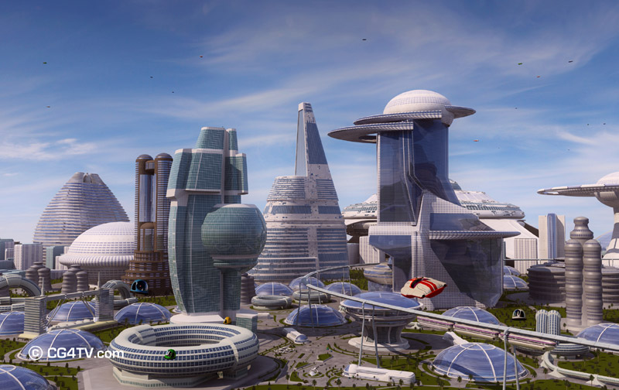
The Future State
3 Overall Considerations
Determining the work that should be done
Making that work flow
Managing the work to achieve continuously improved performance

Slide 20
The Future State
Determining the work that should be done
Eliminate delays
Improve quality
Reduce unnecessary cost, labor effort, frustration
“Maximum results through minimum effort.”
Eliminate waste by eliminating work and/or adding work.
The Basics:
Standardize the work
Build in quality at the source
Install visual management

Slide 21
The Future State
Making that work flow
Uncover barriers to flow and determining the causes
Common barriers to flow: batching, system downtime, interruptions, prioritization
Ways to achieve flow
Combine tasks to reduce handoffs, re-sequence work, make previously sequential activities parallel

Slide 22
The Future State
Managing the work to achieve continuously improved performance
Monitor the work
Track Key Performance Indicators (KPI)

Slide 23
Request Spec. Review
[0]
0
In Review
[2]
0
Finalize Instruments
[0]
0
MDES Development
[12]
0
MDES QC
[2]
.5
4
.5
16
4
OMB/IRB
[??]
Added processes
3x40
120
1x.5
0
Code List Generation
[24]
0
BAH QC
[4]
0
XSD
[2]
0
VDR Data Model
[80]
0
Deployment Package
2x2
40
24
24
240
206/718
29%
206/478
43%
Removed processes
Request
MDES Spec
[0]
0
MDES Spec
[80]
0
.5
120

Slide 24
Request Spec. Review
[0]
0
In Review
[2]
0
Finalize Instruments
[0]
0
MDES Development
[24]
0
MDES QC
[2]
.5
4
.5
40
4
Added processes
OMB/IRB
[??]
1x.5
3x40
120
0
ETL
[4]
0
XSD
[.5]
0
VDR Data Model
[.5]
0
Deployment Package
4
.5
.5
After
113.5/415.5
27%
113.5/175.5
65%
Before
206/717.5
29%
206/477.5
43%
Data Viz
[.5]
Added processes
.5
Request
MDES Spec
[0]
0
MDES Spec
[80]
0
.5
120

Slide 25
Next Steps…
Transformation Plan
Managing the Transformation

Slide 26
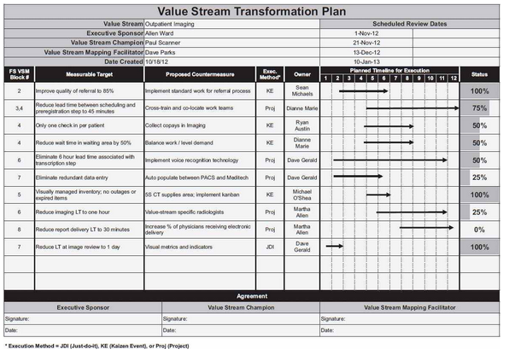
Next Steps…

Slide 27
Questions?
E n d

